Slide 1

SQL PROJECT -
PROPERTY LISTING ANALYSIS FOR PROPERTY RENTAL COMPANY
NAME:-Manoj Ray
BATCH:-PD13
NO:-PD013_13

Slide 2

PROPERTY LISTING ANALYSIS
Property listing study of data to extract information and insights from data and apply knowledge to get actionable insights

Slide 3

CLEANING DATA
Cleaning data is most useful teams in data analysis removing unwanted stuff is helps us to improve data information accuracy
So, finding first is there any NULL or NAN values in column or rows
I have two main table for analyze our data For Greece country
1) Athens city 2) thesasolaniki city
Importing a data in SQL and finding important insights , in here I am also using excel Dashboard to present the data.

Slide 4

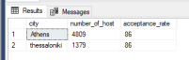
1. Acceptance Rate
As compared to both the city by having the difference in host we are having the same acceptance rate.

Slide 5

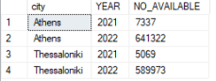
2. availability
As shown in the graph we can check the availability of the property by city with yearly base and can check peak and peak off by compared with years.

Slide 6

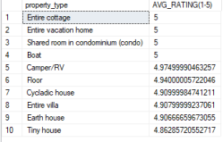
3. Customer category Rating
Rating are given by the customers, so as per the graph we can take the category wise avg rating of the customers

Slide 7

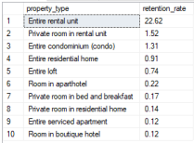
4.Retention Rate
Retention rate means percentage of existing customers who remain customers after a given period
As shown in the graph and output we can see the category wise retention rate of the customers.

Slide 8

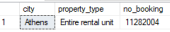
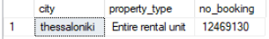
5.Best performing category for the company
Company checks which category is best by checking the insights,
As shown in the figure the Entire rental unit is best property_type for both the City.

Slide 9


